Slide 1
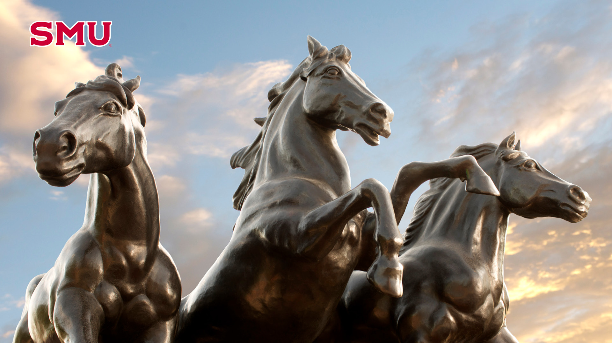

SMU Mock Trial
Summer 2025 Information Session

Slide 2

Agenda
This slideshow will be posted on our website.
What is Mock Trial?
Why Try Out for Mock Trial?
Past Mock Trial Successes
What to Expect from the 2025 Season
2025 Tryout Process
How to Submit Your Tryout

Slide 3
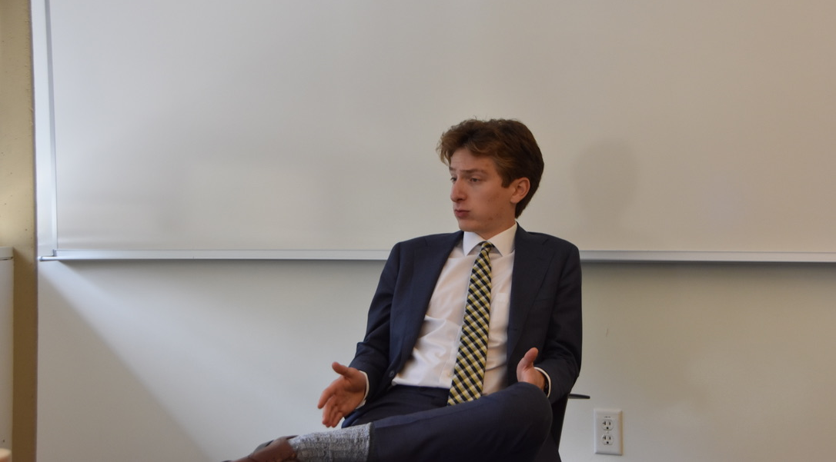
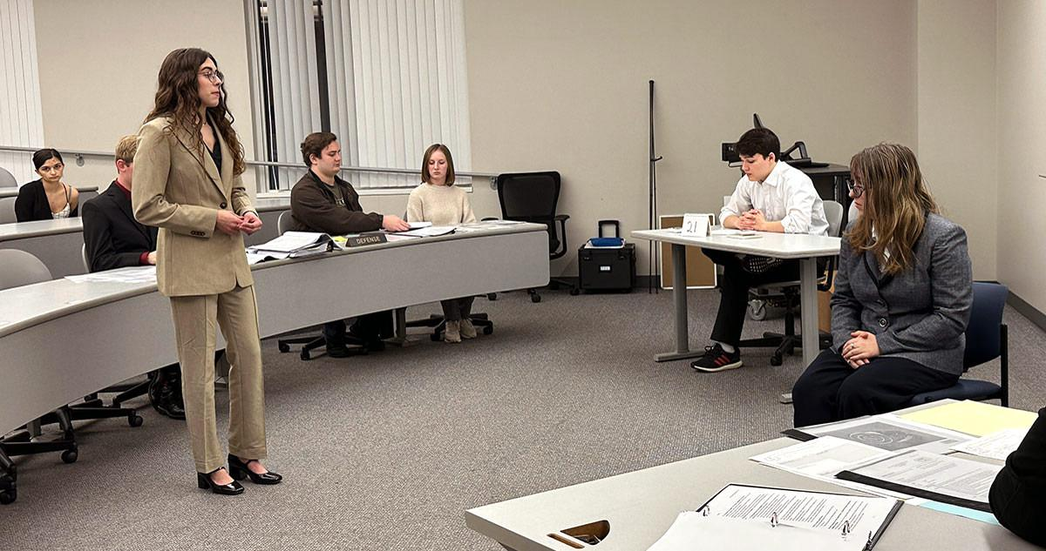
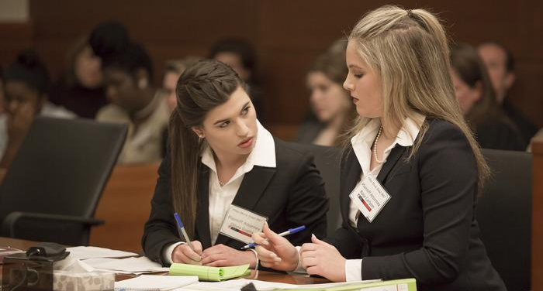







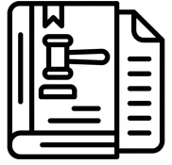
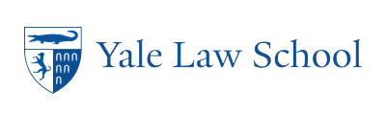
What is Mock Trial?
Founded in 2000, our organization provides unparalleled legal education to undergraduates.
What is Mock Trial?
Not Just Pre-Law Students
Witnesses
Attorneys
Utility
Major Breakdown
Students examine witnesses, make objections, and give speeches in front of legal professionals.
Students take the witness stand embodying characters that have pre-written affidavits.
Students participate in a real-world trial format that prepares them to be future litigators.
Dedman, Humanities.
Lyle, Engineering.
Cox, Business.
Simmons, Education.
Meadows, Arts.
Recent Post-Grad Placements
What do you learn?
Lit Analysis
Public Speaking
Critical Thinking
Legal Knowledge

Slide 4
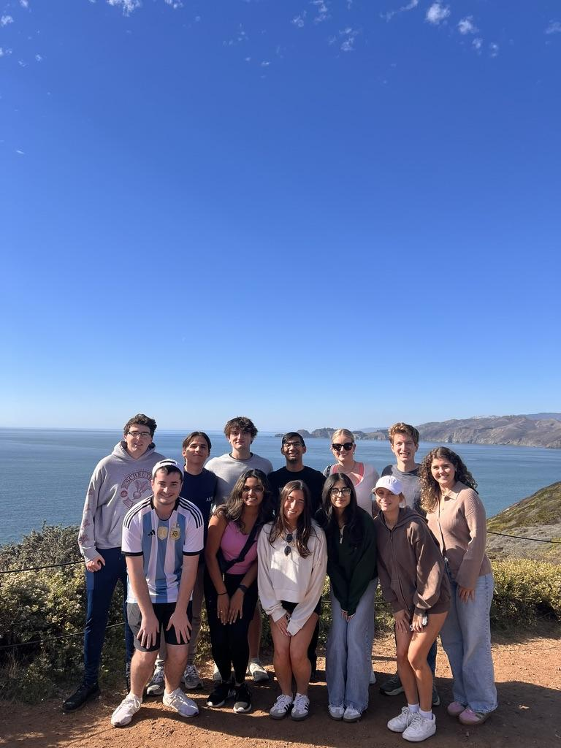
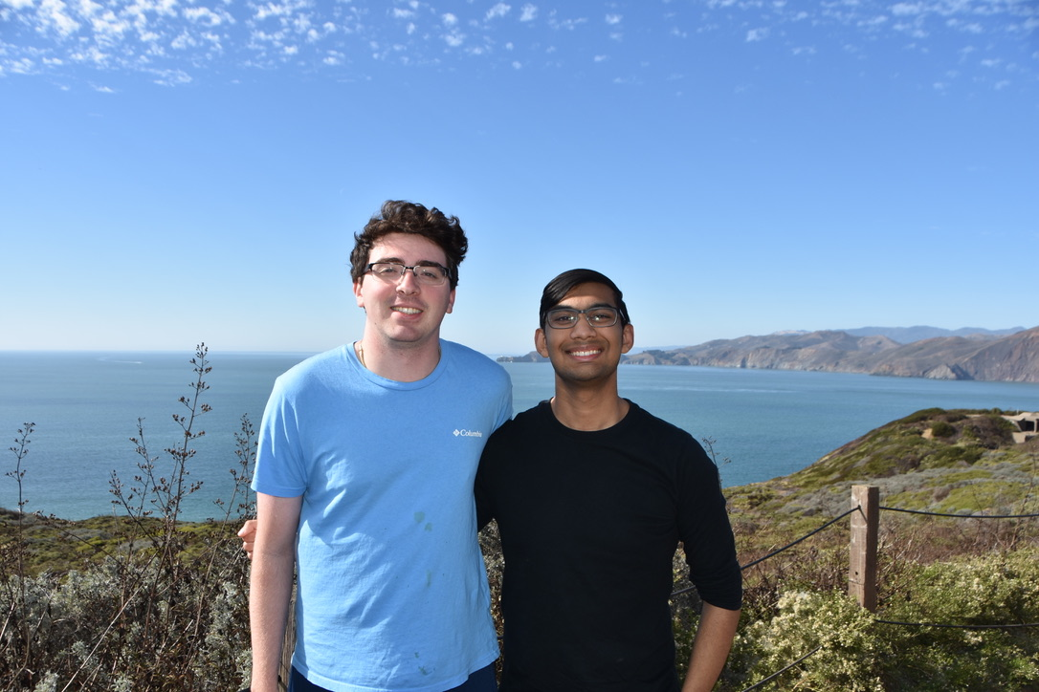
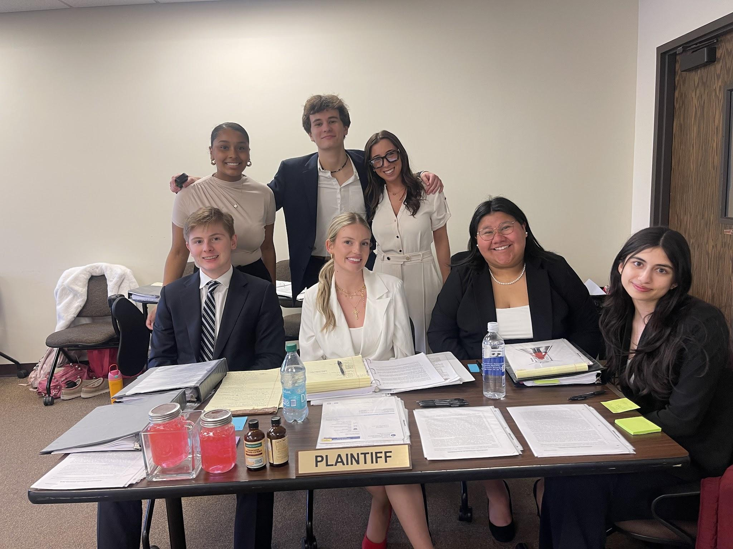
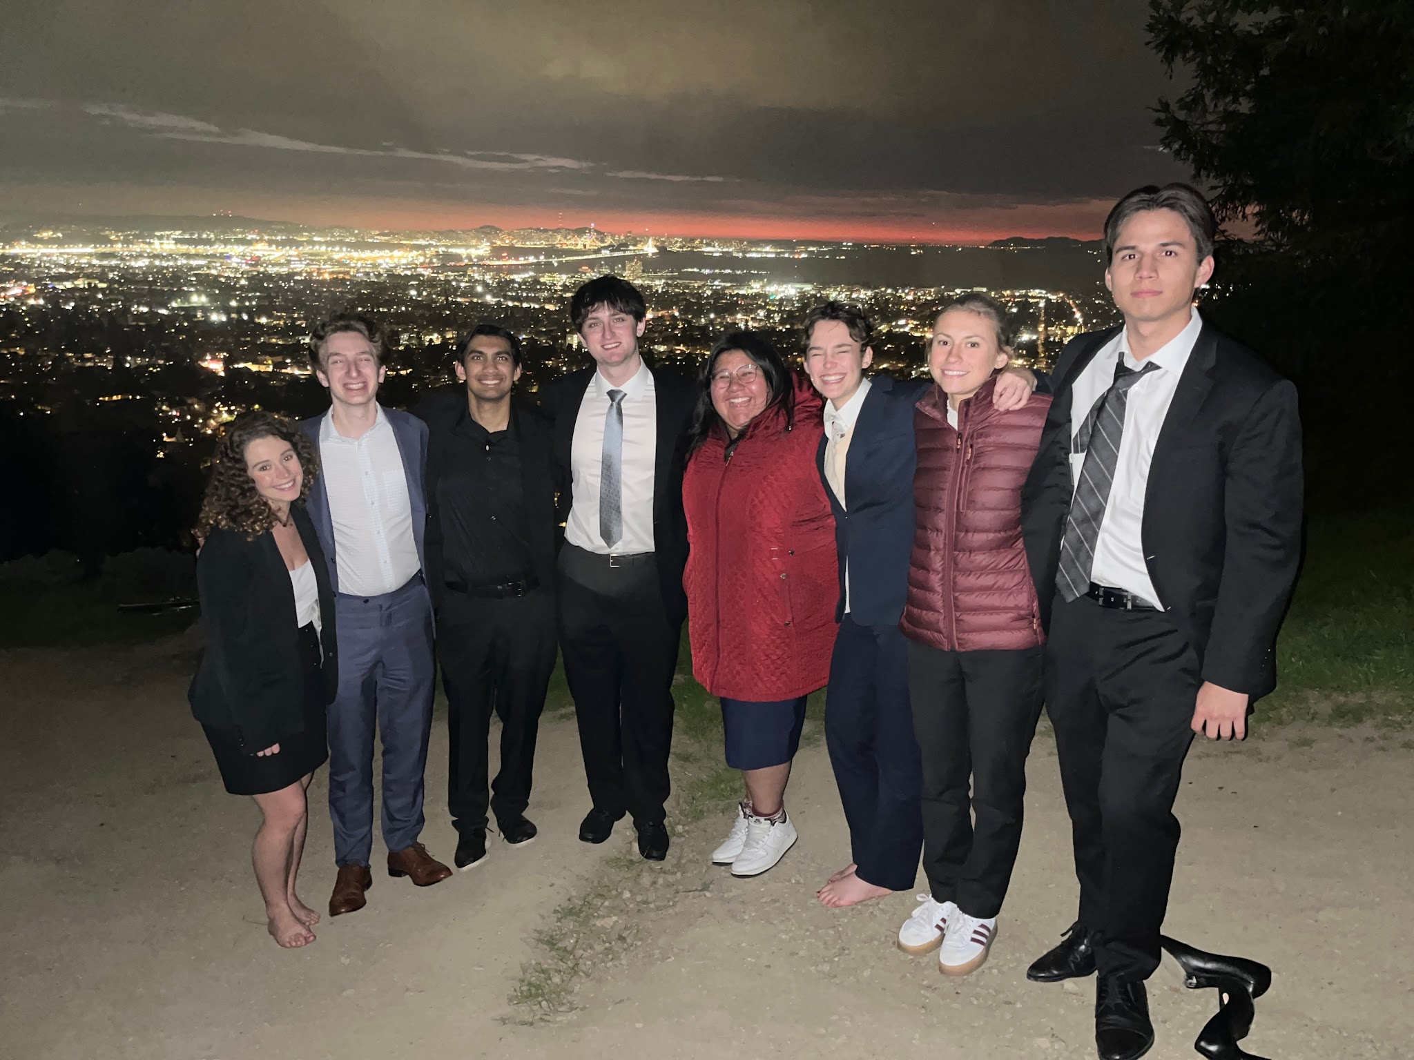
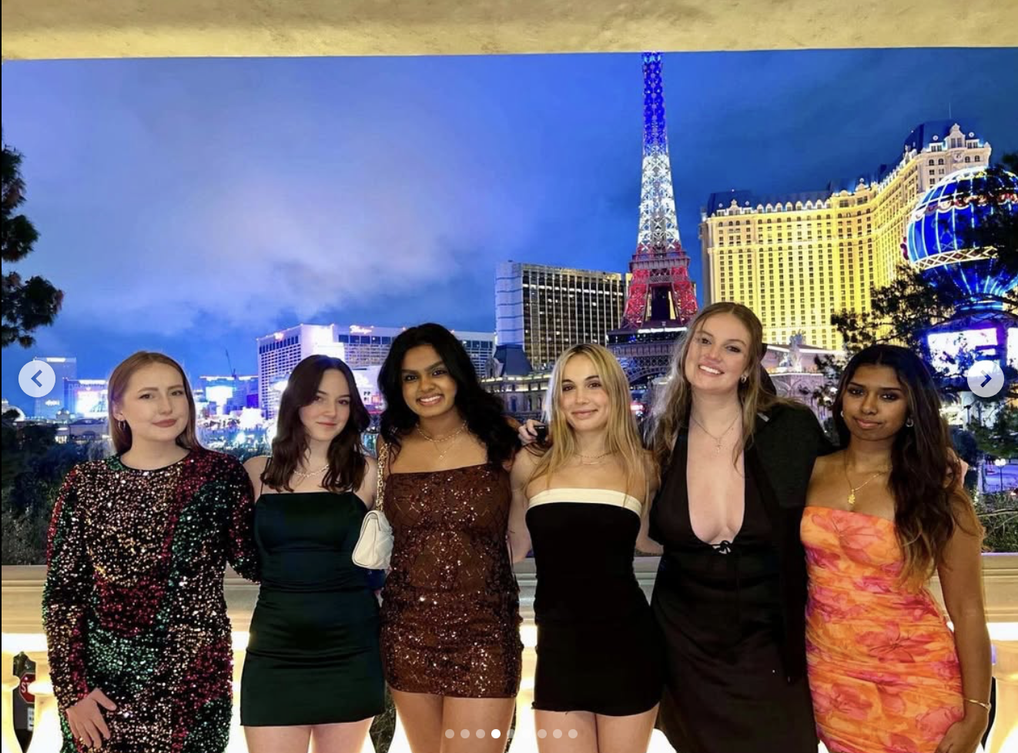
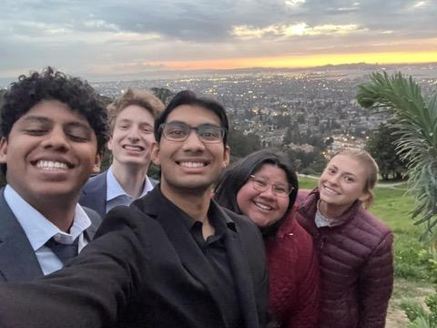
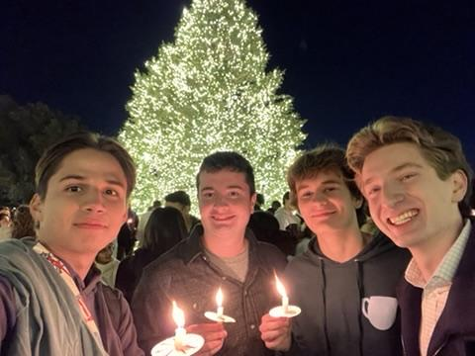
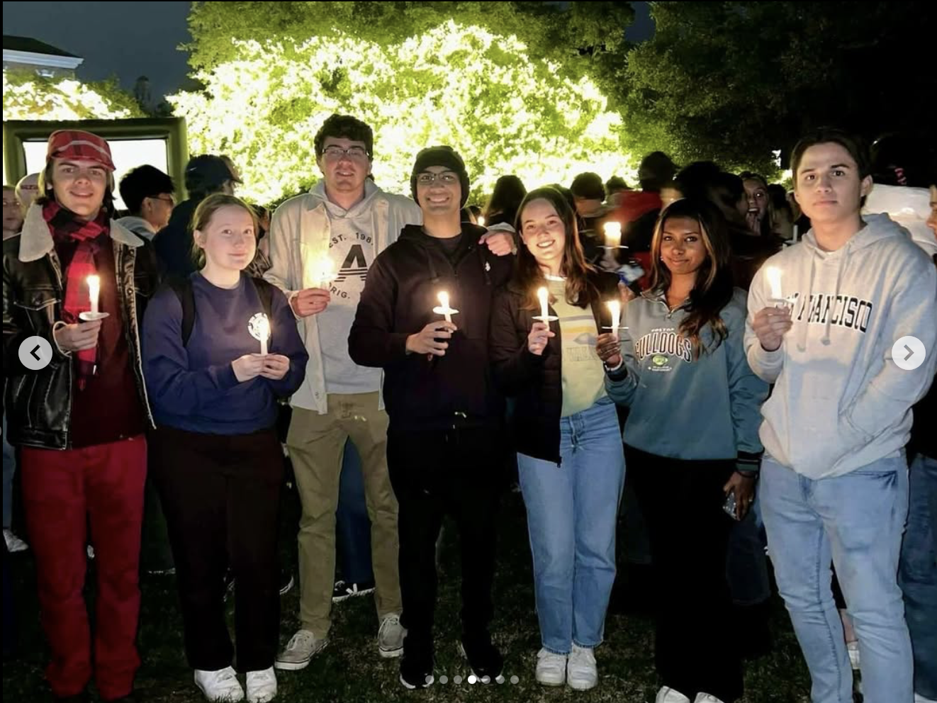
Why Try Out?
Not just an org on-campus, but a true family
Mock Trial provides a tight-knit family of 30+ students from the first week of school.
Mock Trial is the only pre-law organization that offers class credit for law-focused courses.
Mock Trial is among the most common extracurriculars for t14 law schools.
Mock Trial trains you to become a fierce public speaker and oral advocate.

Slide 5







Past Mock Trial Successes
Our team travels across the country; this year we went to Florida, California, Texas, Tennessee, and Louisiana
Tournament Results
.
1st Place at Rice Invitational
1st Place at A&M Invitational
3rd Place at UC Berkeley Invitational
3rd Place at USC Invitational
5th Place at Vanderbilt Invitational
5th Place at Stanford Invitational
And for the first time in program history,
our A and B team qualified for the Opening Round of the National Championship!

Slide 6

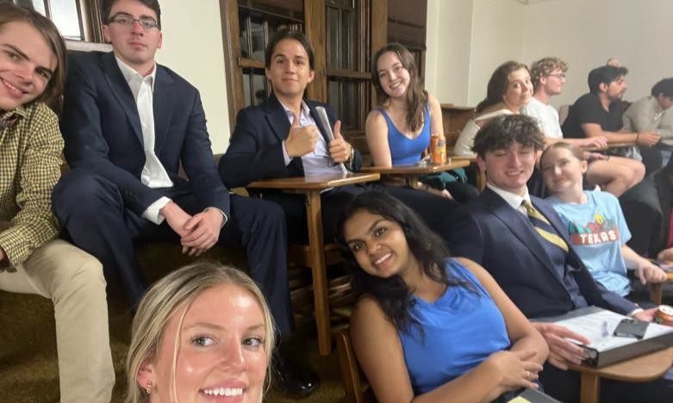
What to Expect from the 2025 Season
Fall 2025
Spring 2026
All new members enroll in the 1-credit-hour Introduction to Mock Trial course (Tu 5-5:50pm).
All members will attend 2 additional weekly practices outside of class.
All new members will compete in 2 Mock Trial tournaments.
All members enroll in the 3-credit-hour Advanced Mock Trial course (TBD).
All members will attend 2 additional weekly practices outside of class.
All members will compete in at least 2 tournaments.

Slide 7
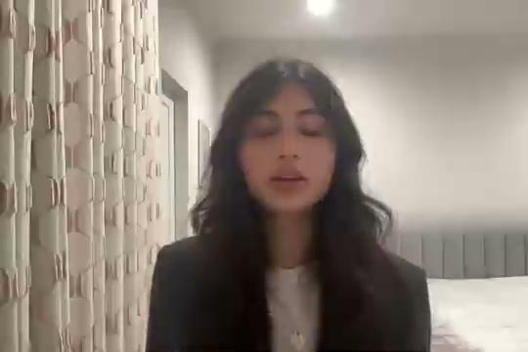
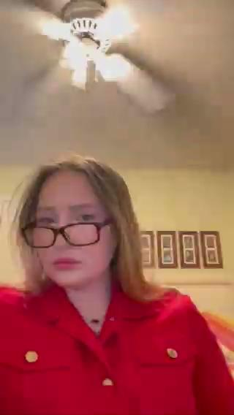
2025 Tryout Process
Every person must submit two videos to tryout.
Two Minute Speech
2. Two Minute Eyewitness Monologue
Two minute argumentative speech answering “Who Killed Peruna?”
Tips:
Feel free to make up testimony, witnesses, and evidence. Present a persuading argument, based on your facts, that eliminates any reasonable doubt.
Speak with clarity, emotion, cadence, and confidence. We care more about delivery than content.
We prefer you to deliver it standing.
Two minute eyewitness testimony based on your affidavit.
**Review the pre-prepared affidavits posted on the webiste
Tips:
Do not constrain yourself to the information in the affidavit. The affidavit is a launchpad.
Emphasize developing a memorable character who is engaging, informative, credible, and entertaining. Use tone, complexion, volume, and cadence to express emotion.

Slide 8
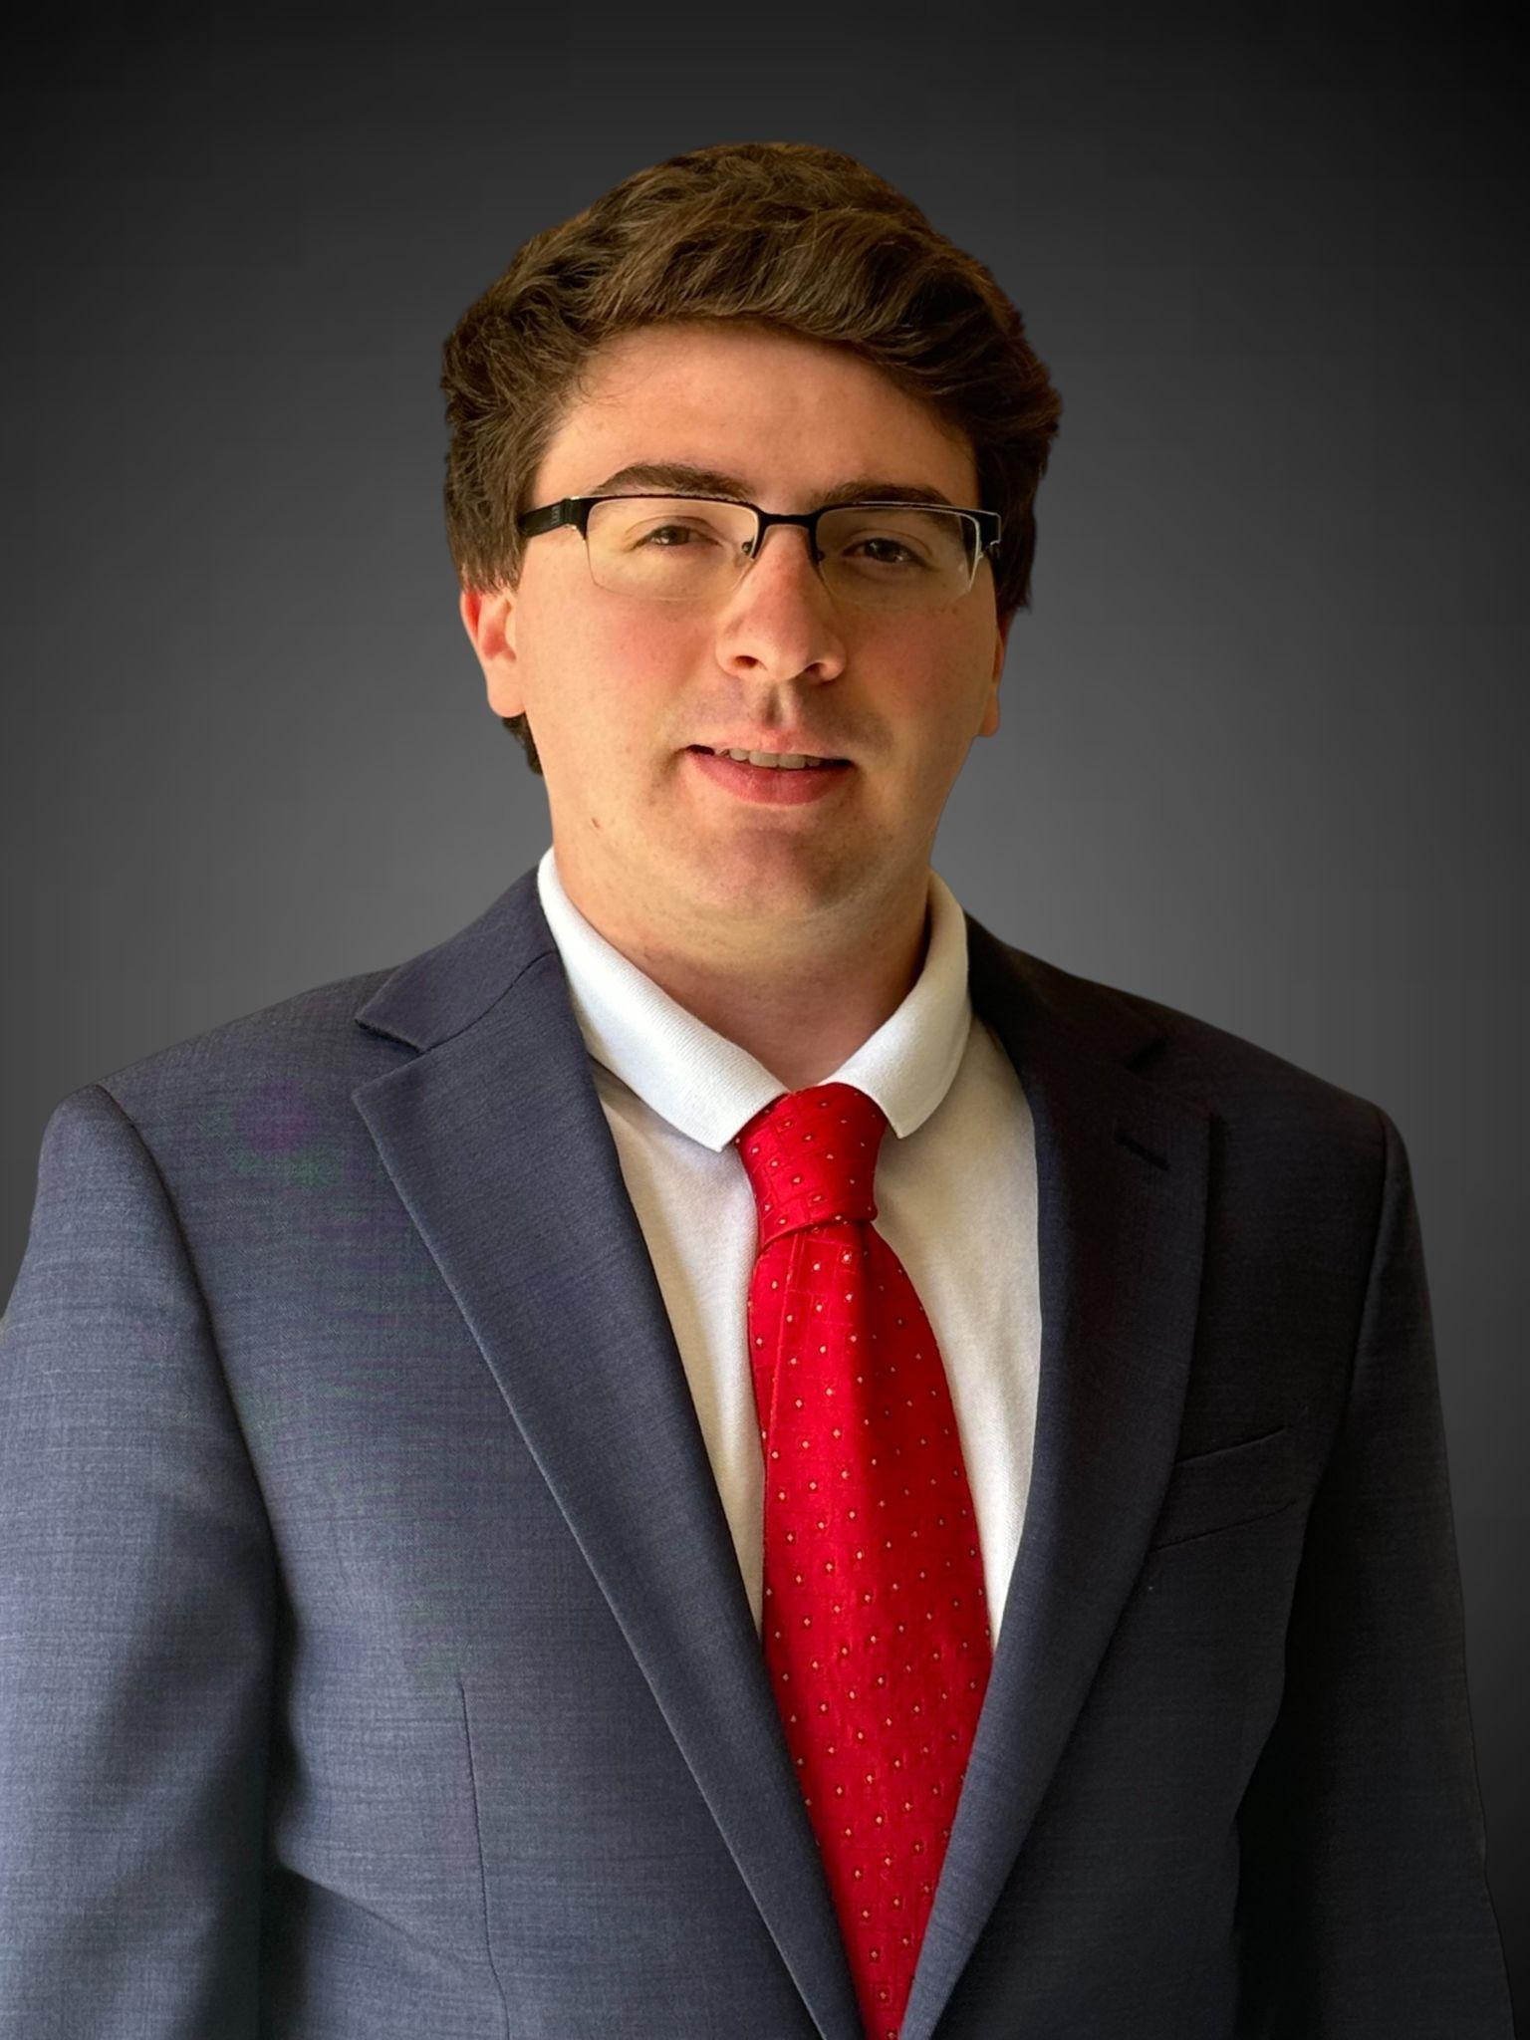
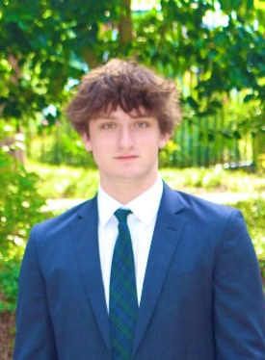
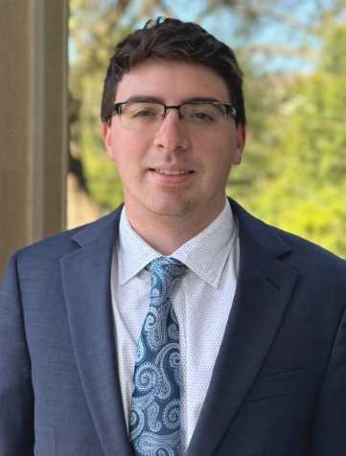
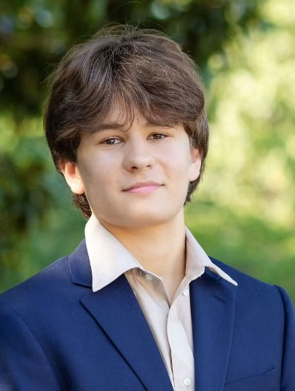
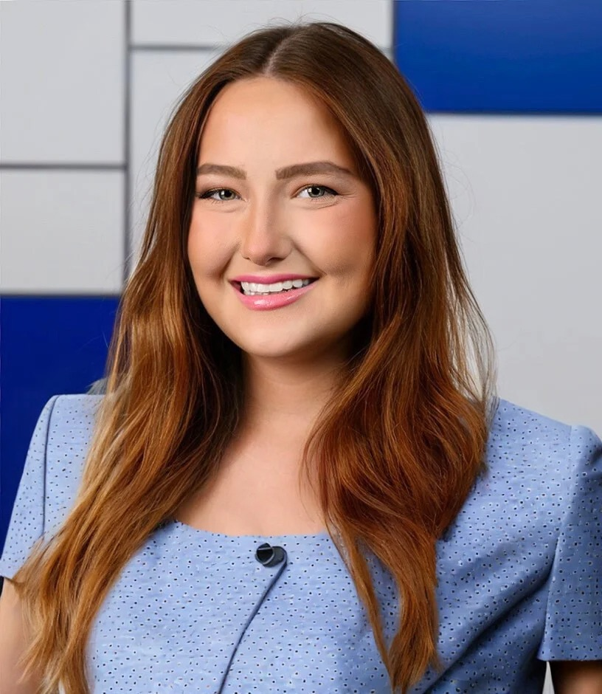
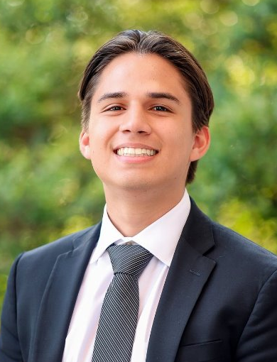
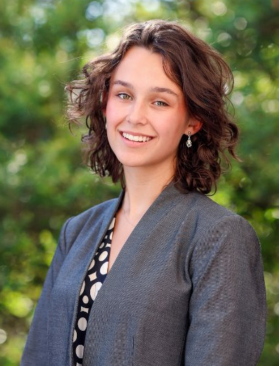
How to Submit Your Tryout
Reach out to anyone on exec if you have any questions!
Tryout Steps
Contact Information
Record your 2-minute “Who Killed Peruna?” speech.
Record your 2-minute “Eyewitness Monologue.”
Upload your videos to youtube, google drive, or dropbox.
Attach your videos’ links to the application form below:
Maxwell Reppucci
President mreppucci@smu.edu
Lachlan Polefka Operations Director lpolefka@smu.edu
Daniel Gonzalez Tournaments Director degonzalez@smu.edu
Jack Litwin
Vice President jlitwin@smu.edu
Gracyn Buckner Membership Director gbuckner@smu.edu
Sophia Graham Fundraising and Alumni Director skgraham@smu.edu
https://www.tinyurl.com/SMUMT2025
*Form due August 10th, 11:59PM CST

